Slide 1

Go, change the world
RV College of
Engineering
ARTIFICIAL INTELLIGENCE AND MACHINE LEARNING
(21AI52)
Unit 5
Dr. K. Viswavardhan Reddy
Department Of AIML

Slide 2
Unit 5
Unsupervised Learning- Overview, What Is Cluster Analysis, Different Types of Clustering’s, Different Types of Clusters
K-means-The Basic K-means Algorithm, Additional Issues, Bisecting K-means, K-means and Different Types of Clusters, Strengths and Weaknesses, K-means as an Optimization Problem
Cluster Evaluation-Overview, Unsupervised Cluster Evaluation Using Cohesion and Separation, Unsupervised Cluster Evaluation Using the Proximity Matrix, Determining the Correct Number of Clusters, Supervised Measures of Cluster Validity, Assessing the Significance of Cluster Validity Measures, Choosing a Cluster Validity Measure

Slide 3
Introduction
Unsupervised learning is a machine learning concept where the unlabeled and unclassified information is analysed to discover hidden knowledge.
The algorithms work on the data without any prior training, but they are constructed in such a way that they can identify patterns, groupings, sorting order, and numerous other interesting knowledge from the set of data.
Unsupervised vs Supervised
Unsupervised: This analysis may reveal an interesting correlation between the features or a common Behaviour within the subgroup of the data, which provides better understanding of the data.
Association
Grouping
Supervised
Prediction
Classification
Example: pushing movie promotions to the correct group of people.

Slide 4
APPLICATIONS OF UNSUPERVISED LEARNING
Segmentation of target consumer populations by an advertisement consulting agency on the basis of few dimensions such as demography, financial data, purchasing habits, etc. so that the advertisers can reach their target consumers efficiently
Anomaly or fraud detection in the banking sector by identifying the pattern of loan defaulters
Image processing and image segmentation such as face recognition, expression identification, etc.
Economic Science: market research
Document clustering and identifying potential labelling options
Data set for the conference attendees

Slide 5
What is Cluster Analysis?
Cluster: A collection of data objects
similar (or related) to one another within the same group
dissimilar (or unrelated) to the objects in other groups
Cluster analysis (or clustering, data segmentation, …)
Finding similarities between data according to the characteristics found in the data and grouping similar data objects into clusters
Text data mining: this includes tasks such as text categorization, text clustering, document summarization, concept extraction, sentiment analysis.
Customer segmentation: creating clusters of customers on the basis of parameters such as demographics, financial conditions, buying habits, etc., which can be used by retailers and advertisers to promote their products in the correct segment.
Anomaly checking: checking of anomalous behaviors such as fraudulent bank transaction, unauthorized computer intrusion, suspicious movements on a radar scanner, etc.
Data mining: simplify the data mining task by grouping a large number of features from an extremely large data set to make the analysis manageable

Slide 6
What is Cluster Analysis?
Finding groups of objects such that the objects in a group will be similar (or related) to one another and different from (or unrelated to) the objects in other groups
Inter-cluster distances are maximized
Intra-cluster distances are minimized

Slide 7
Quality: What Is Good Clustering?
A good clustering method will produce high quality clusters with
high intra-class similarity
low inter-class similarity
The quality of a clustering result depends on both the similarity measure used by the method and its implementation
The quality of a clustering method is also measured by its ability to discover some or all of the hidden patterns

Slide 8
Notion of a Cluster can be Ambiguous
How many clusters?
Six Clusters
Two Clusters
Four Clusters

Slide 9
TYPES OF DATA IN CLUSTER ANALYSIS

Slide 10
Similarity and Dissimilarity
Similarity
Numerical measure of how alike two data objects are
Value is higher when objects are more alike
Often falls in the range [0,1]
Dissimilarity (e.g., distance)
Numerical measure of how different two data objects are
Lower when objects are more alike
Minimum dissimilarity is often 0
Upper limit varies
Proximity refers to a similarity or dissimilarity

Slide 11
Data Structures
Data matrix : Object by variable structure
(two modes)
Dissimilarity matrix: object by object
(one mode)
This represents n objects, such as persons, with p variables (also called measurements or attributes), such as age, height, weight, gender, race and so on. The structure is in the form of a relational table, or n-by-p matrix (n objects x p variables)
This stores a collection of proximities that are available for all pairs of n objects.
It is often represented by a n — by — n table, where d(i,j) is the measured difference or dissimilarity between objects i and j.
In general, d(i,j) is a non-negative number that is close to 0 when objects i and j are higher similar or “near” each other and becomes larger the more they differ.
Since d(i,j) = d(j,i) and d(i,i) =0
This is also called as one mode matrix since the rows and columns of this represent the same entity.

Slide 12
Type of data in clustering analysis
Interval-scaled variables
Binary variables
Nominal, ordinal, and ratio variables
Variables of mixed types

Slide 13
Interval-valued variables
Interval-scaled variables are continuous measurements of a roughly linear scale.
Typical examples include weight and height, latitude and longitude coordinates (e.g., when clustering houses), and weather temperature.
The measurement unit used can affect the clustering analysis.
For example, changing measurement units from meters to inches for height, or from kilograms to pounds for weight, may lead to a very different clustering structure.
To help avoid dependence on the choice of measurement units, the data should be standardized. Standardizing measurements attempts to give all variables an equal weight.

Slide 14
Interval-valued variables
Standardize data
Calculate the mean absolute deviation:
where
Calculate the standardized measurement (z-score)
Using mean absolute deviation is more robust than using standard deviation

Slide 15
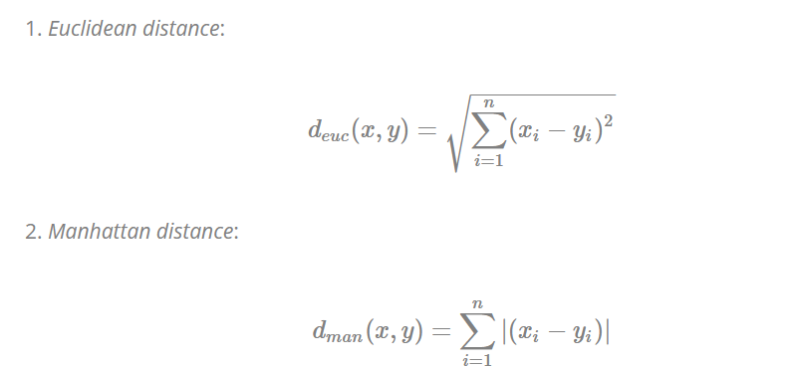

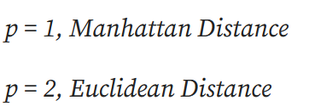
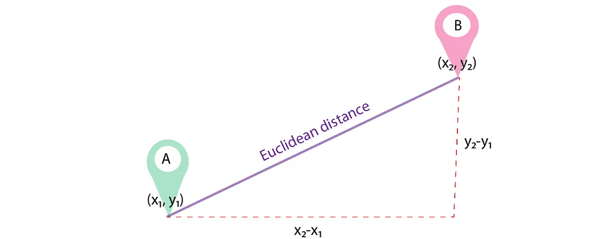
Similarity and Dissimilarity Between Objects
Minkowski distance

Slide 16
Binary Variables
A contingency table for binary data
Distance measure for symmetric binary variables:
Distance measure for asymmetric binary variables:
Jaccard coefficient (similarity measure for asymmetric binary variables):
Object j
Object i

Slide 17
Dissimilarity between Binary Variables
Example
gender is a symmetric attribute
the remaining attributes are asymmetric binary
let the values Y and P be set to 1, and the value N be set to 0
a is the number of attributes that equal 1 for both objects i and j,
b is the number of attributes that equal 1 for object i but equal 0 for object j,
c is the number of attributes that equal 0 for object i but equal 1 for object j, and
d is the number of attributes that equal 0 for both objects i and j.

Slide 18
Comment on the Result
What does the measurement suggest?
These measurements suggest that Jim and Mary are unlikely to have a similar disease because they have the highest dissimilarity value among the three pairs.
Of the three patients, Jack and Mary are the most likely to have a similar disease.

Slide 19
Nominal Variables
A generalization of the binary variable in that it can take more than 2 states, e.g., red, yellow, blue, green
Method 1: Simple matching
m: # of matches, p: total # of variables
Method 2: use a large number of binary variables
creating a new binary variable for each of the M nominal states

Slide 20
Ordinal Variables
An ordinal variable can be discrete or continuous
Order is important, e.g., rank
Can be treated like interval-scaled
replace x_{if} by their rank
map the range of each variable onto [0, 1] by replacing i-th object in the f-th variable by
compute the dissimilarity using methods for interval-scaled variables

Slide 21
Variables of Mixed Types
A database may contain all the six types of variables
symmetric binary, asymmetric binary, nominal, ordinal, interval and ratio
One may use a weighted formula to combine their effects
f is binary or nominal:
d_{ij}^{(f)} = 0 if x_{if} = x_{jf} , or d_{ij}^{(f)} = 1 otherwise
f is interval-based: use the normalized distance
f is ordinal or ratio-scaled
compute ranks r_{if} and
and treat z_{if} as interval-scaled

Slide 22
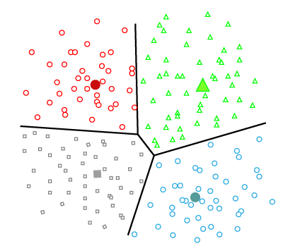
Different types of clustering – Hierarchical and Partitioning
An entire collection of clusters is commonly referred to as a clustering, and in this section, we distinguish various types of clusterings:
Partitioning approach: divides data into non-hierarchical groups.
Centroid based method
Dataset – divided into k-set of groups (k is pre-defined)
Cluster center is created - distance between the data points of one cluster is minimum
Distance between the another clusters is maximum.

Slide 23
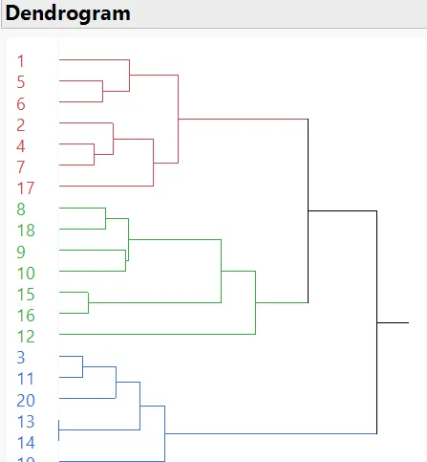
Different types of clustering – Hierarchical and Partitioning
Hierarchical approach: divides data into clusters to create a tree-like structure, which is also called a dendrogram.
Dataset – divided into k-set of groups (k is not pre-defined)
Pre-defined order - top to bottom manner.
Agglomerative Hierarchical algorithm

Slide 24
Different types of clustering – Exclusive versus Overlapping versus Fuzzy
Exclusive: Assign each object to a single cluster.
In the most general sense, an overlapping or non-exclusive clustering is used to reflect the fact that an object can simultaneously belong to more than one group (class).
For instance, a person at a university can be both an enrolled student and an employee of the university.
In a fuzzy clustering, every object belongs to every cluster with a membership weight that is between 0 (absolutely doesn’t belong) and 1 (absolutely belongs).
In other words, clusters are treated as fuzzy sets. (Mathematically, a fuzzy set is one in which an object belongs to any set with a weight that is between 0 and 1.
Marketing: Fuzzy clustering can be used to segment customers based on their preferences and purchasing behavior, allowing for more targeted marketing campaigns.
Medical diagnosis: Fuzzy clustering can be used to diagnose diseases by grouping patients with similar symptoms together.

Slide 25
Different types of clustering – Complete versus Partial
A complete clustering assigns every object to a cluster, whereas a partial clustering Not every object needs to be assigned.
Motivation: some objects in a dataset may not belong to well defined groups
Noise, outliers, or simply “uninteresting background” data

Slide 26
Types of clusters

Slide 27
Types of Clusters
Well-separated clusters
Center-based clusters
Contiguous clusters
Density-based clusters
Property or Conceptual
Described by an Objective Function

Slide 28
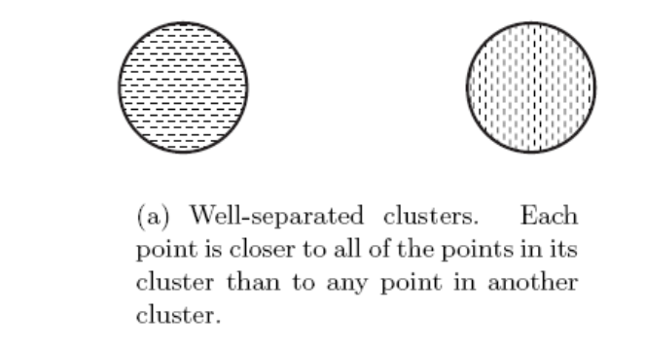
Types of Clusters: Well-Separated
Well-Separated Clusters:
A cluster is a set of points such that any point in a cluster is closer (or more similar) to every other point in the cluster than to any point not in the cluster.

Slide 29
Types of Clusters: Center-Based
Center-based
A cluster is a set of objects such that an object in a cluster is closer (more similar) to the “center” of a cluster, than to the center of any other cluster
The center of a cluster is often a centroid, the average of all the points in the cluster, or a medoid, the most “representative” point of a cluster
4 center-based clusters

Slide 30
Types of Clusters: Contiguity-Based
Contiguous Cluster (Nearest neighbor or Transitive)- NEXT OR TOGETHER
A cluster is a set of points such that a point in a cluster is closer (or more similar) to one or more other points in the cluster than to any point not in the cluster.
8 contiguous clusters

Slide 31
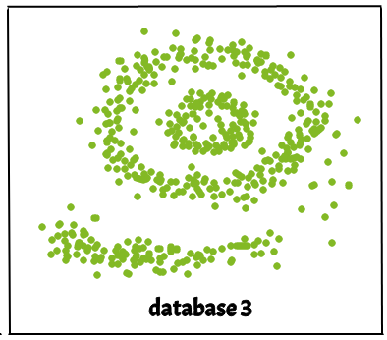
Types of Clusters: Density-Based
Density-based – useful for identifying arbitrarily shaped clusters
A cluster is a dense region of points, which is separated by low-density regions, from other regions of high density.
Used when the clusters are irregular or intertwined, and when noise and outliers are present.

Slide 32
Types of Clusters: Conceptual Clusters
Shared Property or Conceptual Clusters
Finds clusters that share some common property or represent a particular concept.
2 Overlapping Circles

Slide 33
Types of Clusters: Objective Function
Clusters Defined by an Objective Function
Finds clusters that minimize or maximize an objective function.
Enumerate all possible ways of dividing the points into clusters and evaluate the `goodness' of each potential set of clusters by using the given objective function. (Non deterministic Polynomial Hard)
Can have global or local objectives.
Hierarchical clustering algorithms typically have local objectives
Partitional algorithms typically have global objectives

Slide 34
Types of Clusters: Objective Function …
Map the clustering problem to a different domain and solve a related problem in that domain
Proximity matrix defines a weighted graph, where the nodes are the points being clustered, and the weighted edges represent the proximities between points
Clustering is equivalent to breaking the graph into connected components, one for each cluster
Want to minimize the edge weight between clusters and maximize the edge weight within clusters

Slide 35
Considerations for Cluster Analysis
Partitioning criteria
Single level vs. hierarchical partitioning (often, multi-level hierarchical partitioning is desirable)
Separation of clusters
Exclusive (e.g., one customer belongs to only one region) vs. non-exclusive (e.g., one document may belong to more than one class)
Similarity measure
Distance-based (e.g., Euclidian, road network, vector) vs. connectivity-based (e.g., density or contiguity)
Clustering space
Full space (often when low dimensional) vs. subspaces (often in high-dimensional clustering)

Slide 36
Requirements and Challenges
Scalability
Clustering all the data instead of only on samples
Ability to deal with different types of attributes
Numerical, binary, categorical, ordinal, linked, and mixture of these
Constraint-based clustering
User may give inputs on constraints
Use domain knowledge to determine input parameters
Interpretability and usability
Others
Discovery of clusters with arbitrary shape
Ability to deal with noisy data
Incremental clustering and insensitivity to input order
High dimensionality

Slide 37
Major Clustering Approaches (I)
Partitioning approach:
Construct various partitions and then evaluate them by some criterion, e.g., minimizing the sum of square errors
Typical methods: k-means, k-medoids, CLARANS
Hierarchical approach:
Create a hierarchical decomposition of the set of data (or objects) using some criterion
Typical methods: Diana, Agnes, BIRCH, CAMELEON
Density-based approach:
Based on connectivity and density functions
Typical methods: DBSACN, OPTICS, DenClue
Grid-based approach:
based on a multiple-level granularity structure
Typical methods: STING, WaveCluster, CLIQUE

Slide 38
Major Clustering Approaches (II)
Model-based:
A model is hypothesized for each of the clusters and tries to find the best fit of that model to each other
Typical methods: EM, SOM, COBWEB
Frequent pattern-based:
Based on the analysis of frequent patterns
Typical methods: p-Cluster
User-guided or constraint-based:
Clustering by considering user-specified or application-specific constraints
Typical methods: COD (obstacles), constrained clustering
Link-based clustering:
Objects are often linked together in various ways
Massive links can be used to cluster objects: SimRank, LinkClus

Slide 39
Partitional Clustering
Original Points
A Partitional Clustering

Slide 40
Hierarchical Clustering
Traditional Hierarchical Clustering
Traditional Dendrogram
Non-traditional Hierarchical Clustering
Non-traditional Dendrogram

Slide 41
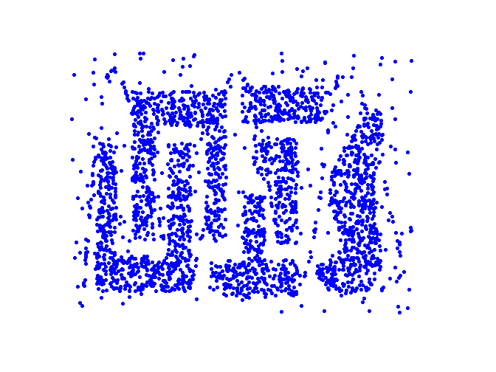
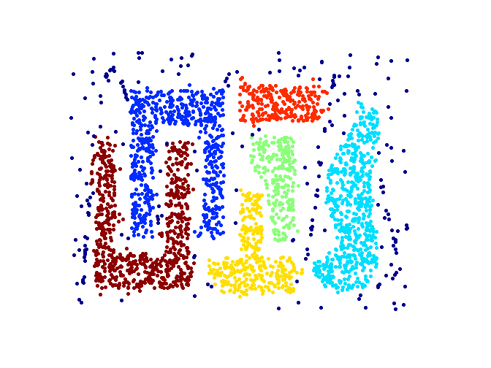
Density based Clustering
Original Points
Clusters

